Slide 1

Program Synthesis through Generalized Planning
Edoardo Cicero
Daniele Giunta
Luca Pierdicca

Slide 2
Overview
Program Synthesis
Generalized Planning
LTL
Strix
Examples (paper/ex novo)
Edoardo Cicero, Daniele Giunta, Luca Pierdicca
31/05/2019
Pagina ‹#›
Notes:
‹#›

Slide 3
Program Synthesis intuition
Since the born of the first Personal Computer, people program computers by giving them explicit instructions
really good at following them extremely quickly
not all the humans are good at write them
What if, instead, we tell the computer what we want, and leave it the details of HOW to figure out?
General objective: automatically construct a program that satisfies a given high-level specification
Edoardo Cicero, Daniele Giunta, Luca Pierdicca
31/05/2019
Pagina ‹#›
Notes:
‹#›

Slide 4
Program Synthesis applied
Our objective: automatically construct programs that involve manipulations of data structures with data fields.
Assumption:
cursors: point to data structures cells
registers: storing data
{sensors}: compare the content of the cells pointed by the cursors (⇾ fixed set of booleans)
{actions}: move the cursors in the structure, copy the content of a pointed cell into another
Edoardo Cicero, Daniele Giunta, Luca Pierdicca
31/05/2019
Pagina ‹#›
Notes:
‹#›

Slide 5
Generalized Planning
This form of synthesis can be dealt with by relying on generalized planning, i.e.: planning for solving a collection of problem instances at once
GPP: collection Q of classical planning instances that share a set of actions and a set of observations
GPP solution: a policy 𝜇 prescribing the (right) actions to execute for solving each planning problem in the collection
T: program synthesis tasks
Q_{T}: generalized planning problem ([Bonet et. al] + non obs goals: do not assume goals are Boolean combinations of observations)
Q^{A}_{T}: abstraction of Q_{T} into a single non-det problem
φ_{LTL}: expression of Q^{A}_{T} into (a set of) LTL formulas
Main contribution: cast prog syn tasks over d.s. of unbounded size as planning problems
T ➜ Q_{T} ➜ Q^{A}_{T} ➜ φ_{LTL}
synth
𝜇
Edoardo Cicero, Daniele Giunta, Luca Pierdicca
31/05/2019

Slide 6
Theoretical framework
A planning instance P is a (deterministic) classical planning problem extended with an observation function. Each instance defines a state model〈S, s0, T, Act, A, f, obs, Ω〉with:
S finite set of states
s0 ∈ S initial state
T set of goal states
Act finite set of actions
A : S → 2^{Act} available-actions function
f : Act 𝗑 S → S deterministic state transition function
obs : S → Ω observation function
Ω finite set of observations
A solution to P is an action sequence a₀,...,a_{n-1} that generates a goal reaching state sequence s₀,...,s_{n}, i.e. s_{n} ∊ T
A generalized problem Q is a set of instances P with the same actions Act and observations Ω and the same observable action preconditions. A solution to Q is a policy that for all problems P in Q it induces a (unique) s.a.-sequence s₀, a₀, s₁, a₁,... that is goal reaching, i.e. s_{n} ∊ T for some n
Edoardo Cicero, Daniele Giunta, Luca Pierdicca
31/05/2019

Slide 7
Theoretical framework
For solving generalized planning problems where goals are not observable an observation abstraction Q^{A} of Q is considered:
A solution to Q^{A} is a policy such that if the trajectories it induces on Q^{O} that satisfy Γ_{F} also satisfy Γ_{G}
Th. If a policy solves a sound observation abstraction Q^{A} of Q then the policy solves Q
Q^{A} = 〈 Q^{O}, Γ_{F} , Γ_{G} 〉
Q^{O}
Γ_{F}
Γ_{G}
Observation projection that captures the possible transitions among observations over the instances P in Q
It is a fully observable non-deterministic domain over Act and Ω (common among the instances P in Q)
Fairness constraints encodes information in the instances P typically about fairness of effects of non-deterministic actions when applied infinitely often
Goals are expressed through constraints on o.a.-trajectories that ensure that the s.a.-trajectories in the instances are goal reaching
Edoardo Cicero, Daniele Giunta, Luca Pierdicca
31/05/2019

Slide 8
Quick Recap on LTL
Temporal constraints: encode properties that hold over the whole sequence of states in a solution plan.
LTL: used to describe temporal relationships between states on a trajectory (sequence of states).
Given a set of atomic propositions P, the grammar for LTL is the following:
φ::= p | ¬φ | 𝜓 ∧ φ | ౦φ | 𝜓Uφ
p ∈ P
¬ and ∧ are logical negation and conjunction
౦φ means that Φ will hold in the next state
𝜓Uφ means that 𝜓 will hold until Φ becomes true
examples:
◻️(r → ¬end) - at every instant in time if end is true now, then i cannot do action r
◻️(s → ౦s ) - it is always the case that if s is true now then next time s will be true
Edoardo Cicero, Daniele Giunta, Luca Pierdicca
31/05/2019
Pagina ‹#›
Notes:
‹#›

Slide 9
Quick Recap on LTL synthesis
LTL synthesis is the problem of producing a controller that achieves a given property no matter how the environment behaves. The idea is that the environment sets the variables in some set X, and the agent then responds by setting the variables in some (disjoint) set Y , and this interaction repeats.
In planning terminology, X can be viewed as a representation of observations (i.e. Ω = 2^{X}), and Y as a representation of actions (i.e. Act = 2^{Y} ). For an LTL formula φ over the variables X∪Y, a policy 𝜇 solves the LTL synthesis problem for the formula φ if every sequence of observations and actions induced by 𝜇 satisfies φ.
Edoardo Cicero, Daniele Giunta, Luca Pierdicca
31/05/2019
Pagina ‹#›
Notes:
‹#›

Slide 10
Formalization of the task
Represent Q^{A} in compact form by LTL formulas Synthesize a policy that solves the following formula: D ∧ ((E ∧ F) ⊃ G) (1)
D,E,F,G are all LTL formulas composed of propositions encoding actions and observations in Q^{A}
D:
-action preconditions
-requirement on doing exactly one action at a time
-once the action stop is executed, it is the only applicable action
E:
-initial conditions
-action effects
-frame axioms (i.e. persistence)
F:
-fairness constraints (“if something is attempted/requested infinitely often, then it will be successful/allocated infinitely often”)
G:
-goal constraints
Th. Every policy that solves the LTL synthesis problem for the formula (1) solves Q
Edoardo Cicero, Daniele Giunta, Luca Pierdicca
31/05/2019
Pagina ‹#›
Notes:
‹#›

Slide 11
Solving the program synthesis task
Given a description of a programming task T
Think of T as a generalized problem Q_{T} and single out the actions and observations that are common between the problem instances
Come up with fairness and goal constraints for the observation abstraction Q^{A}_{T} of Q_{T}
Express the LTL formulas D, E, F, G that characterize Q^{A}_{T}
Automatically solve the LTL synthesis problem for the formula D ∧ ((E ∧ F) ⊃ G) and output a solution (controller/policy) 𝜇 for Q^{A}_{T} if one exists

Slide 12
Strix
In order to obtain controllers for program synthesis tasks, it is recommended to use the tool Strix (https://strix.model.in.tum.de/try/)
Strix provides a direct translation of LTL formulas (in our case D,E,F,G formulas) into deterministic parity automata (DPA) and an efficient, multi-threaded explicit state solver for parity games, giving a strategy represented as an automaton
Edoardo Cicero, Daniele Giunta, Luca Pierdicca
31/05/2019
Pagina ‹#›
Notes:
‹#›

Slide 13
Examples
Edoardo Cicero, Daniele Giunta, Luca Pierdicca
31/05/2019

Slide 14
Traversing a tree
Visit all nodes once starting from the root. We assume a memory where nodes to be visited can be stored and retrieved, initially containing the root only.
Observations:
em(pty) (memory is empty),
ha(s children) (current node’s children have not been put in memory)
Actions:
e(xtract a node from memory):
PRE: all children of current node are in list
POST: remove current node
p(ut all children of current node into memory):
PRE: no child of current node is in list
POST: put all children of current node into memory
s(top)
Edoardo Cicero, Daniele Giunta, Luca Pierdicca
31/05/2019
Pagina ‹#›
Notes:
‹#›

Slide 15
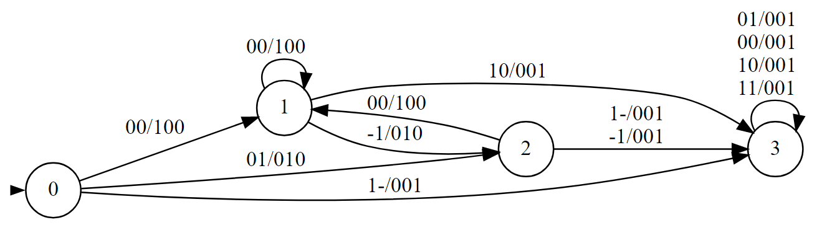
Traversing a tree
Formula D (Preconditions):
- ◻️(e ⊕ p ⊕ s) ∧ ◻️(s → 𐩒s)
- ◻️(e → ¬em)
- ◻️(p → ha)
Formula E (Initial condition, effects, frame)
- ¬em
- ◻️(p → 𐩒(¬em ∧ ¬ha))
- ◻️(s → (PERSISTS(em) ∧ PERSISTS(ha)))
Formula F (Fairness):
- (◻️♢e) → ♢(em ∧ ¬ha)
Formula G (Goals): visit all nodes once,
- ♢◻️(em ∧ ¬ha)
- ◻️(ha → (¬e U p))
Observations(input): em, ha
Actions(output): e, p, s
Legenda: em ha / e p s
Edoardo Cicero, Daniele Giunta, Luca Pierdicca
31/05/2019
Pagina ‹#›
Notes:
‹#›

Slide 16
Minimum of a list
The task is to return in a register the minimum number of a finite, singly-linked list. We assume the cursor starts on the first cell and that the first element of the list is the actual minimum. A register can be updated with the value stored in the currently pointed cell, and one can check whether the value in the pointed cell is less than the one in the register.
Observations:
e(nd) (cursor at last cell)
lt (value stored in pointed cell is less than that in register)
Actions:
r(ight) (to move the cursor):
PRE: the element pointed by the cursor is not the last of the list
POST: the cursor points to the following element
u(pdate) (to update the register with the minimum value of the list):
PRE: the number pointed by the cursor is less than the one in the register
POST: the register contains the element pointed by the cursor
s(top)
Edoardo Cicero, Daniele Giunta, Luca Pierdicca
31/05/2019
Pagina ‹#›
Notes:
‹#›

Slide 17
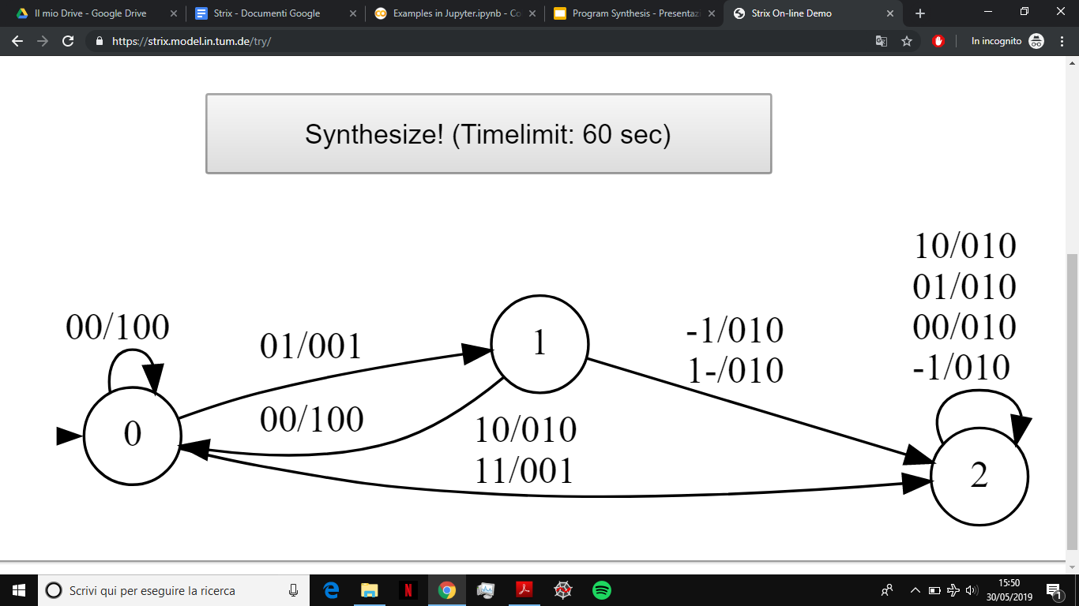
Minimum of a list
Formula D (Preconditions):
-◻️(r ⊕ u ⊕ s) ∧ ◻️(s → ⚪s)
-◻️(r → ¬e)
Formula E (Effects): initial condition, effects, frame
-◻️(u → (⚪(¬lt) ∧ PERSISTS(e)))
-◻️(s → (PERSISTS(e) ∧ PERSISTS(lt)))
Formula F (Fairness):
-(◻️♢r) → ♢e
Formula G (Goals): visit all cells once and update the register iff the value pointed by the cursor is smaller than the one in the register
-♢◻️e
-◻️(u ↔ lt)
Observations: e, lt
Actions: r, s, u
Legenda: e lt / r s u
Edoardo Cicero, Daniele Giunta, Luca Pierdicca
31/05/2019
Pagina ‹#›
Notes:
‹#›

Slide 18
Copy even numbers of a list into a new list
The task is to retrieve all the even numbers from a singly-linked list and put them into another one. Everytime an even number is sensed it is added to the new list. We assume the cursor starts on the first cell.
Observations:
e(nd) (cursor at last cell)
even (value stored in pointed cell is even)
(has)put (the even number has been put into the list of only even numbers)
Actions:
r(ight) (to move the cursor):
PRE: the element pointed by the cursor is not the last of the list
POST: the cursor points to the following element
a(dd) (to add the even number to the list of only even numbers):
PRE: the number pointed by the cursor is even and it has not been put in the new list yet
POST: the even number pointed by the cursor is added to the new list
s(top)
Edoardo Cicero, Daniele Giunta, Luca Pierdicca
31/05/2019
Pagina ‹#›
Notes:
‹#›

Slide 19
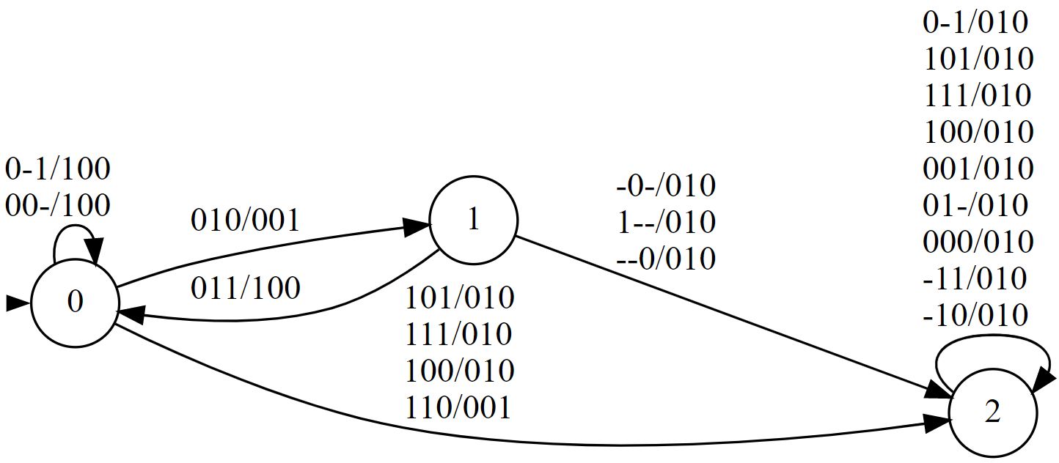
Copy even numbers of a list into a new list
Formula D (Preconditions):
-◻️(r ⊕ a ⊕ s) ∧ ◻️(s → 𐩒s)
-◻️(r → ¬e)
Formula E (Effects): initial condition, effects, frame
-◻️(a → (⚪(hasput) ∧ PERSISTS(even) ∧ PERSISTS(end)))
-◻️(s → (PERSISTS(end) ∧ PERSISTS(hasput) ∧ PERSISTS(even))
Formula F (Fairness):
-(◻️♢r) → ♢e
Formula G (Goals): visit all cells once and add to the new list the element pointed by the cursor iff it is even and it has not been put inside that yet
-♢◻️e
-◻️(a ↔ (even ∧ ¬hasput)))
Observations: e, even, hasput
Actions: r, s, a
Legenda:
e even hasput / r s a
Edoardo Cicero, Daniele Giunta, Luca Pierdicca
31/05/2019
Pagina ‹#›
Notes:
‹#›

Slide 20
Membership in a tree
Check whether a finite tree contains a node with a value equal to that stored in a register
Observations:
em(pty) (memory is empty),
ha(s children) (current node’s children have not been put in memory)
eq(ual) (current node is equal to that one in the register)
Actions:
e(xtract a node from memory):
PRE: all children of current node are in list
POST: remove current node
p(ut all children of current node into memory):
PRE: no child of current node is in list
POST: put all children of current node into memory
s(top)
Edoardo Cicero, Daniele Giunta, Luca Pierdicca
31/05/2019
Pagina ‹#›
Notes:
‹#›

Slide 21
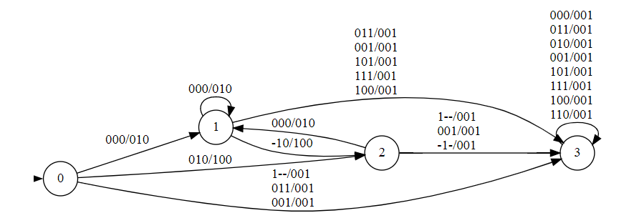
Membership in a tree
Formula D (Preconditions):
- ◻️(e ⊕ p ⊕ s) ∧ ◻️(s → 𐩒s)
- ◻️(e → ¬em)
- ◻️(p → ha)
Formula E (Initial condition, effects, frame)
- ¬em
- ◻️(p → ⚪(¬em ∧ ¬ha))
- ◻️(s → (PERSISTS(em,ha,eq)))
Formula F (Fairness):
- (◻️♢e) → ♢(em ∧ ¬ha)
Formula G (Goals): no children left unexplored
- (♢◻️(em ∧ ¬ha)) or (♢◻️(end))
- ◻️((ha ∧ ¬eq)→ (¬e U p))
- ◻️(eq → s)
Observations(input): em, ha, eq
Actions(output): e, p, s
Legenda: em ha eq / e p s
Edoardo Cicero, Daniele Giunta, Luca Pierdicca
31/05/2019
Pagina ‹#›
Notes:
‹#›

Slide 22
Bubble sort
Input: list of n integers to be sorted
State: [cursor, swap_mem] - cursor = current cursor position ∊ {0, … ,n-2} swap_mem = last iteration swap status ∊ {True, False}
Observations:
changed (in the last iteration a swap has happened),
lte (the element at position cursor is less then or equal to the element at position cursor+1)
end (the cursor is at the last position of the list (n-2))
Actions:
sw(ap two consecutive elements of the list):
PRE: element at cursor is gt then the element at cursor+1
POST: element at cursor is lte then the element at cursor+1 - swap_mem = True
r(ight) - sum 1 to the current cursor value:
PRE: the cursor is not at the last position of the list
POST: the cursor is moved by one position on the right
b(egin) - initialize cursor at 0
PRE: the cursor is at the last position of the list and we swapped in the last iteration
POST: the cursor is at the first position of the list - swap_mem = False (reset)
st(op)

Slide 23
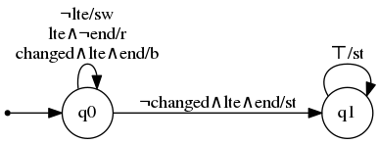
Bubble sort
Formula D (preconditions):
- ◻️(sw ⊕ b ⊕ st ⊕ r) ∧ ◻️(st → ⚪st)
- ◻️(r → (¬end ∧ lte))
- ◻️(sw → ¬lte)
- ◻️(b → (end ∧ changed ∧ lte))
Formula E (initial condition, effects, frame)
- ¬changed
- ◻️(b → (⚪(¬end ∧ changed) ∧ PERSISTS(lte)))
- ◻️(sw → (⚪(lte) ∧ PERSISTS(end,changed)))
- ◻️(st → (PERSISTS(end,changed,lte)))
Formula F (fairness):
- (◻️♢r) → ♢(end ∧ ¬changed ∧ lte)
Formula G (goals):
- ♢(end ∧ ¬changed ∧ lte)
Observations(input): changed, lte, end
Actions(output): sw, st, r, b

Slide 24
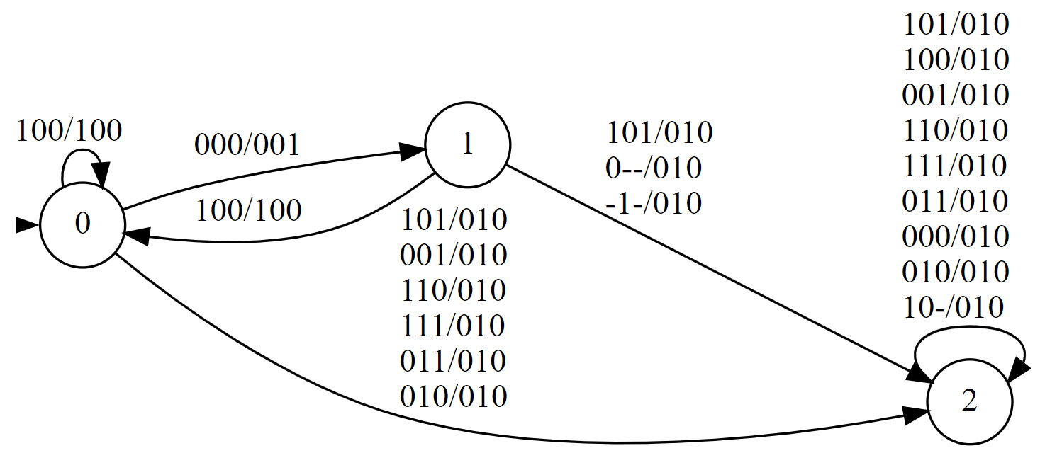
Sum (of positive numbers) greater than a constant (not working)
Formula D (Preconditions):
- ◻️((r ∧ ¬s ∧ ¬a) || (¬r ∧ s ∧ ¬a) || (¬r ∧ ¬s ∧ a)) ∧ ◻️(s → 𐩒(s))
- ◻️(r → (¬end ∧ ¬isgreater ∧ summed))
- ◻️(a → (¬summed ∧ ¬isgreater))
Formula E (effects, frame)
- ◻️(a → (𐩒(summed) ∧ (end ↔ 𐩒(end))
- ◻️(s → ((end ↔ 𐩒(end)) ∧ (summed ↔ 𐩒(summed)) ∧ (isgreater ↔ 𐩒(isgreater))))
Formula F (Fairness):
- ◻️(♢(r)) → ♢(end ))
Formula G (Goals):
- ♢(◻️(end ∨ isgreater )) ∧ ◻️(isgreater → s) )
Observations(input): summed, end, isgreater
Actions(output): r, s, a
Legenda: summed end isgreater / r s a
Edoardo Cicero, Daniele Giunta, Luca Pierdicca
31/05/2019
Pagina ‹#›
Notes:
‹#›

